Slide 1
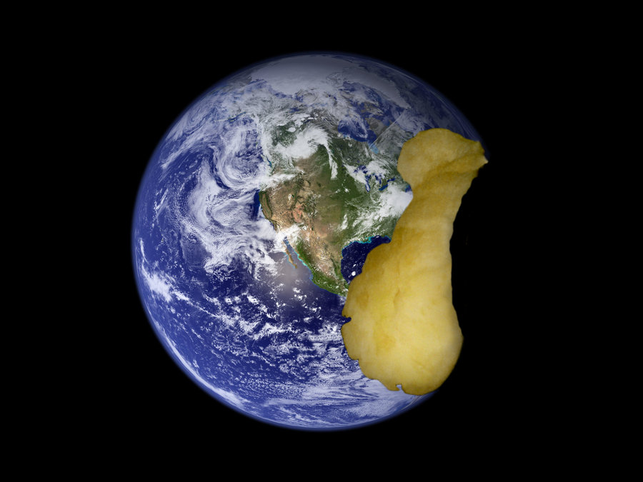
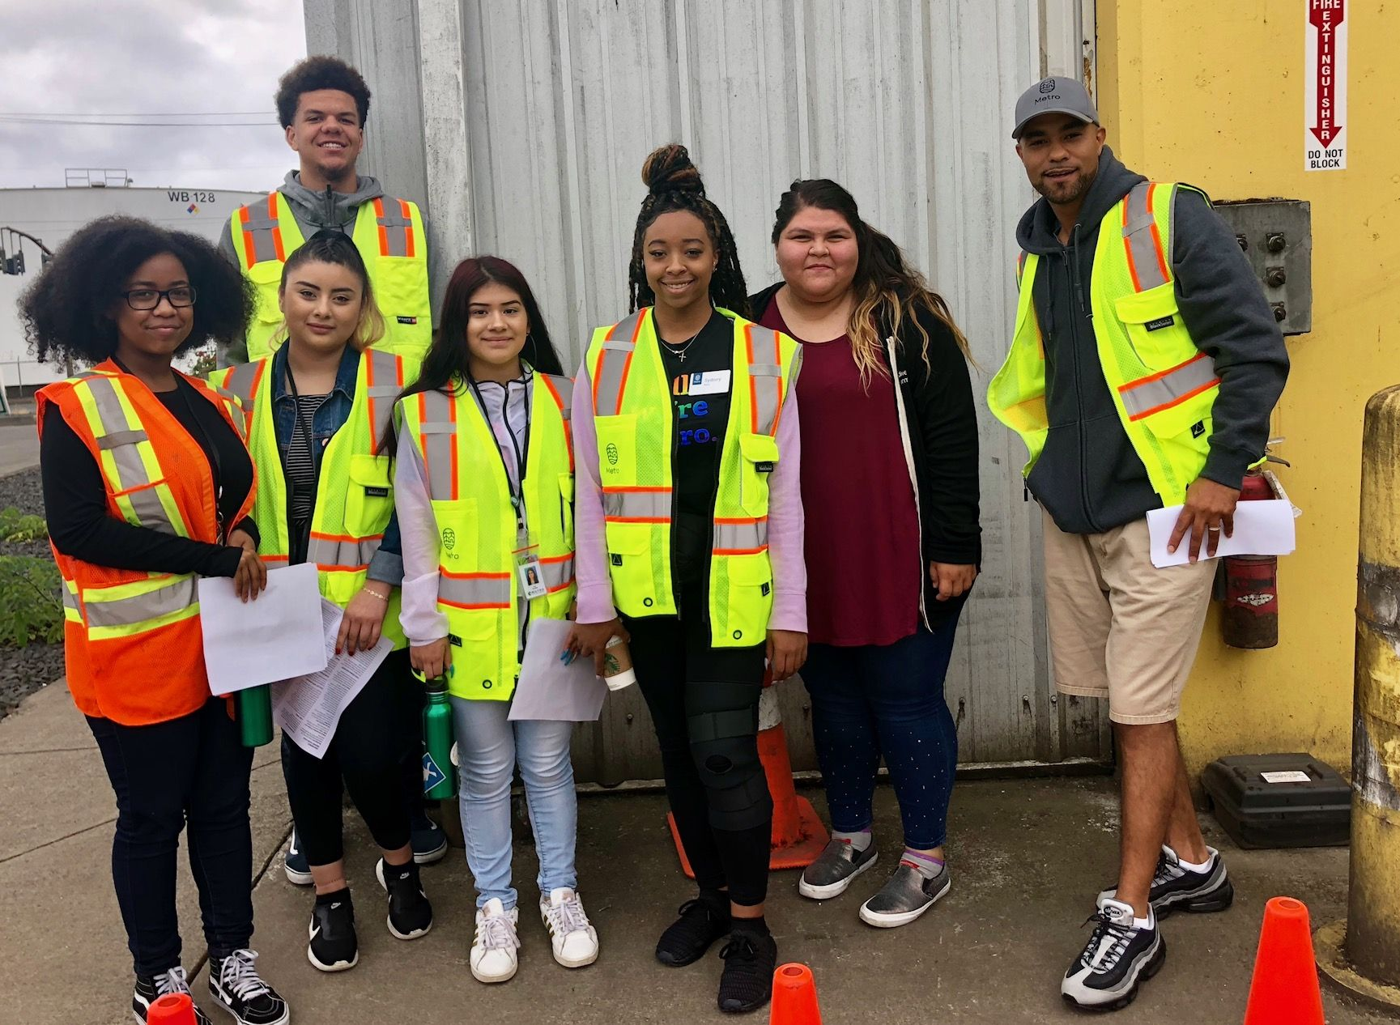
Plan, Shop, Chop! Food systems, food waste and climate change

Slide 2
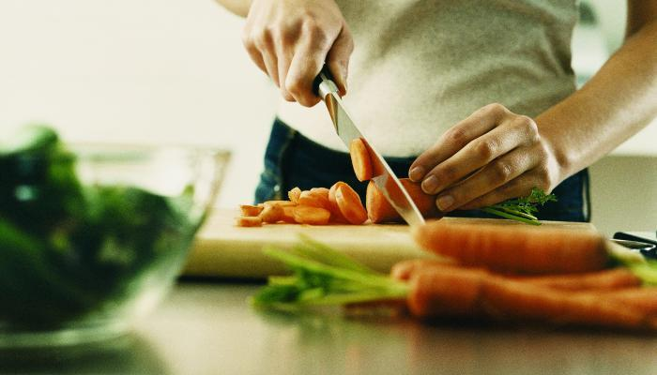
Plan, shop, chop!

Slide 3
Selecting your menu
 | Unit | Cost per unit ($) | Number of Units | Sub-Total (cost x units):
Proteins
Beef | 1 lb | $8
Chicken | 1 lb | $3 | 2 | $6
Pork | 1 lb | $3
Tofu (soybeans) | 1 lb | $3
Fish (salmon) | 1 lb | $11
Grains/Starch
Rice (white) | 1 lb | $1 | 1 | $1
Noodles (wheat) | 1 lb | $1
Corn | 1lb | $1
Potatoes | 1 lb | $1
Vegetables
Asparagus | 1 lb | $3
Broccoli | 1 lb | $2 | 1 | $2
Carrots | 1 lb | $1 | 1 | $1
Onion | 1 lb | $1
Green peppers | 1 lb | $2
Drinks
Coffee | 1 lb | $4
Milk | 1 gal | $3
Total $: |  |  |  | $10
Select up to 4 food or beverage items from the table.
Keep units in whole numbers (for instance: 1.0 or 2.0, not 0.5 or 0.75)
You are building a meal for a group of 4 people.

Slide 4
Budgeting
$1
Every bill is one dollar!

Slide 5
Let’s collect our resources
1) Fill in the table below with the four foods you chose to use and the number of natural resource chips (water, land, air) you collect for each food. Then, add up the total amount of resource chips used.
Write the number of chips in each box
Food item | # of Units | Water | Land | Fuel | Sub-total
1.
2.
3.
4.
 |  |  |  | Total Resources
Remember! More units means more chips.

Slide 6
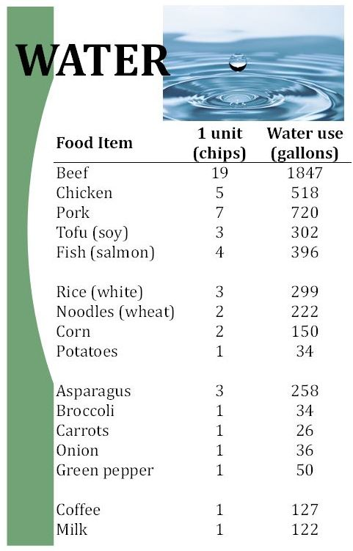
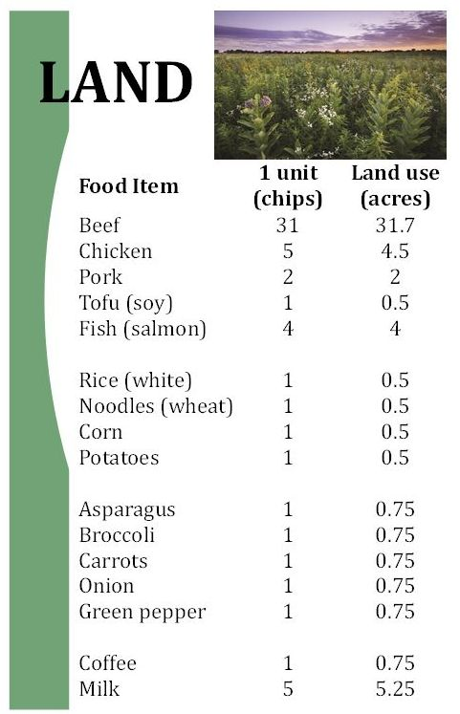
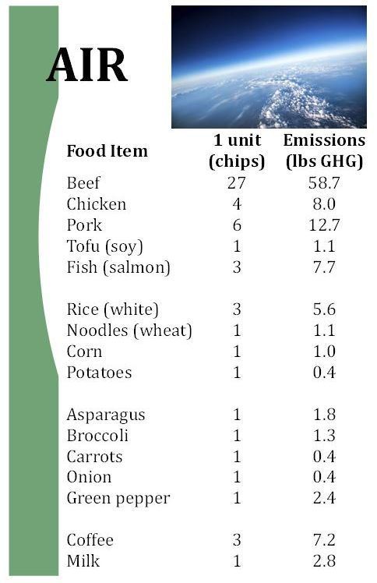
Natural resource use

Slide 7
Reflection
Which food(s) from your menu used the most of each natural resource? Which food(s) overall used the most of each natural resource?
How do you think natural resources are used in producing food?

Slide 8
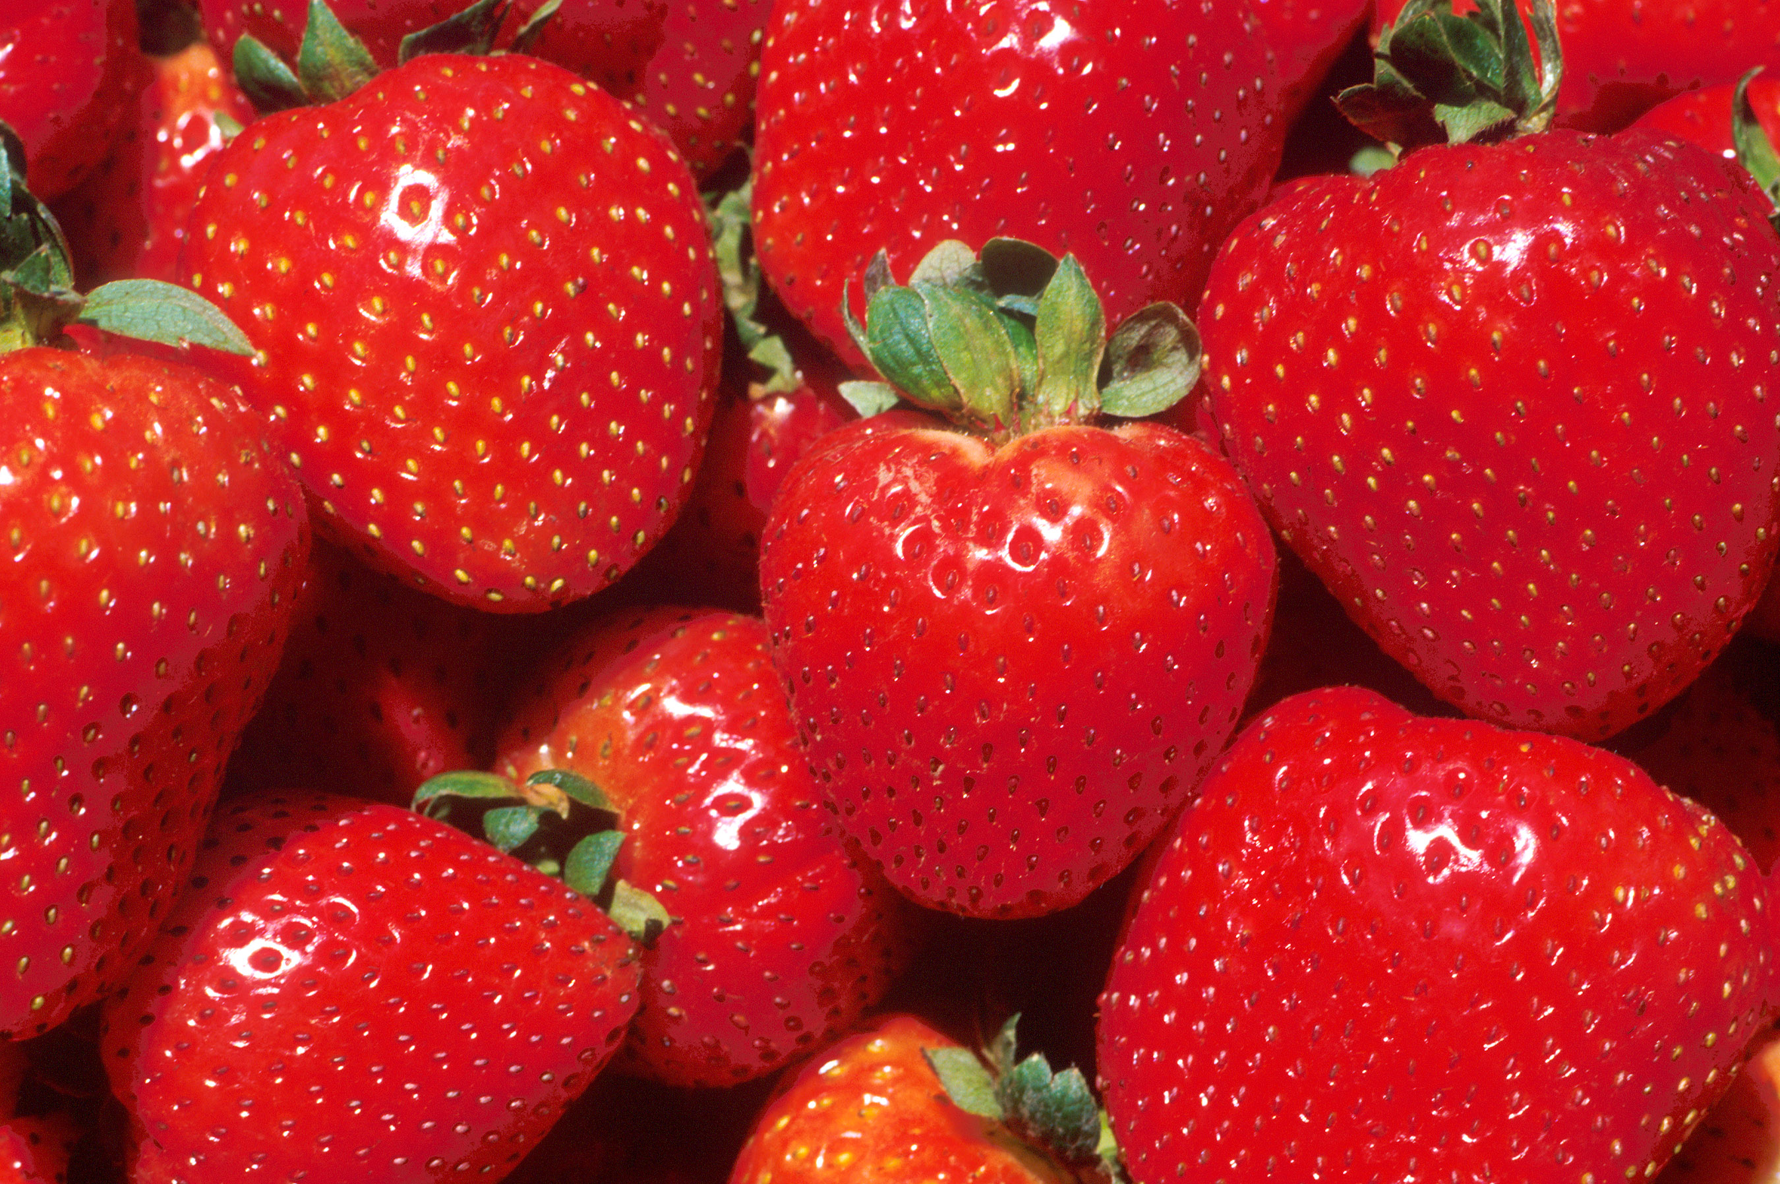
“The Extraordinary Life and Times of Strawberry”
https://www.youtube.com/watch?v=t7EhXK-G090
Created by the Ad Council

Slide 9
How much food did you lose?
2) In the United States, % of food is wasted.
Use the formula below to calculate how much of your resources are lost:
x 0.4 =
total number of resources used number of resources lost

Slide 10
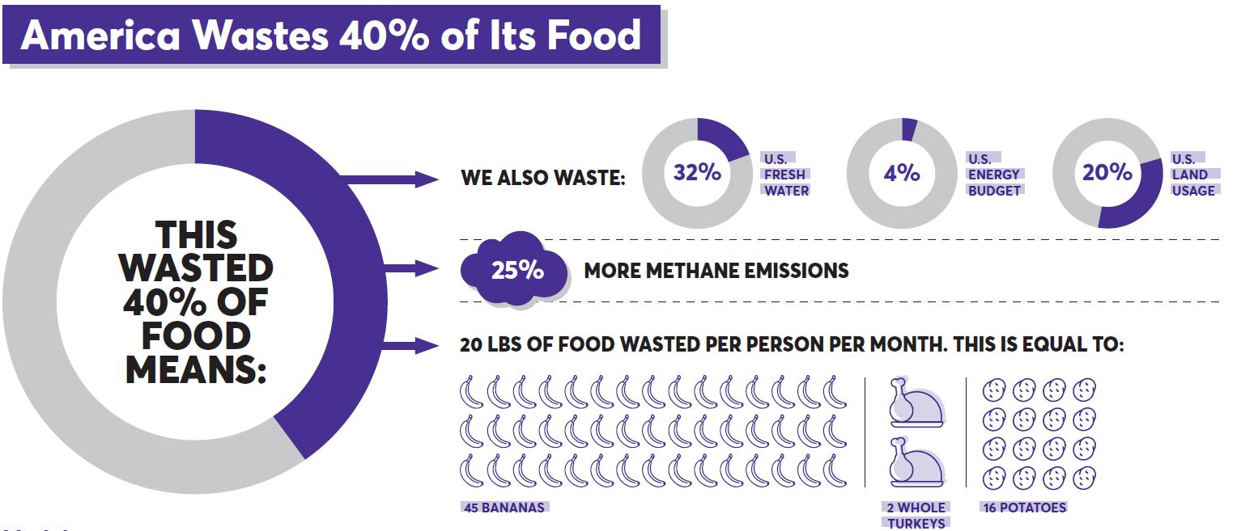
What does this waste mean?
Image from the James Beard Foundation

Slide 11
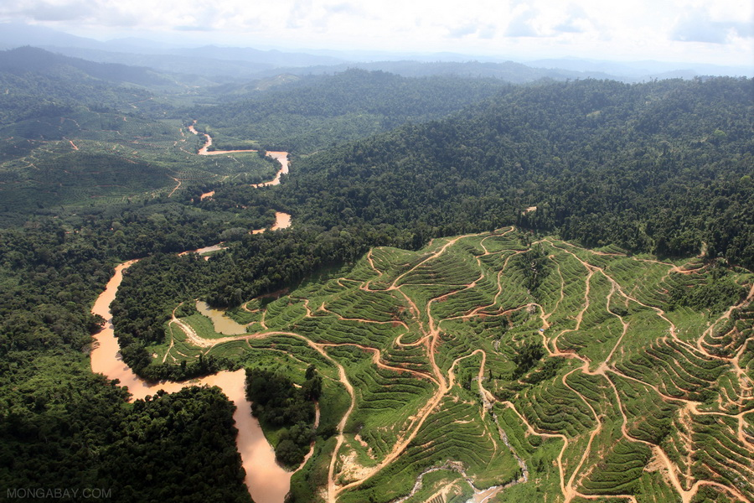
Who else uses that land?
Nearly 70% of the Sumatran elephant’s habitat has been destroyed in one generation, due to palm oil plantations.

Slide 12
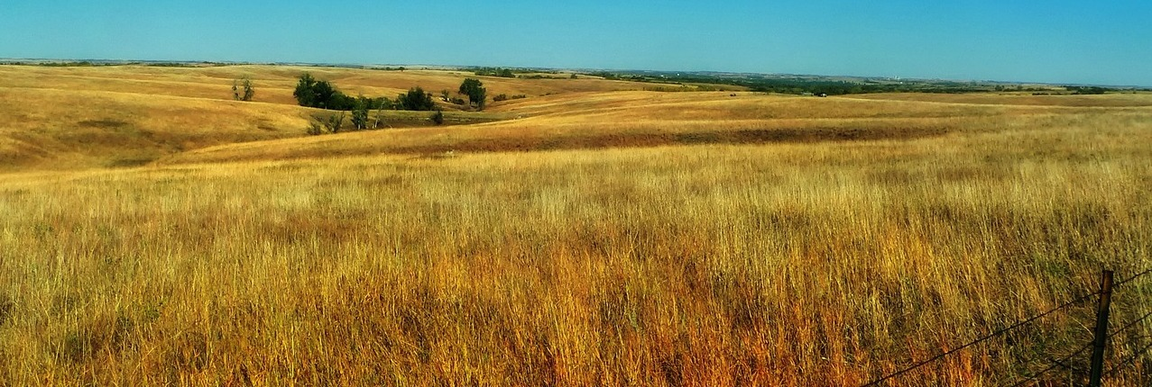
Who else uses that land?
The United States used more than 75 million acres of land to grow soy in 2013-2014. That’s an area larger than the state of Arizona!
Notes:
Black-footed ferret

Slide 13
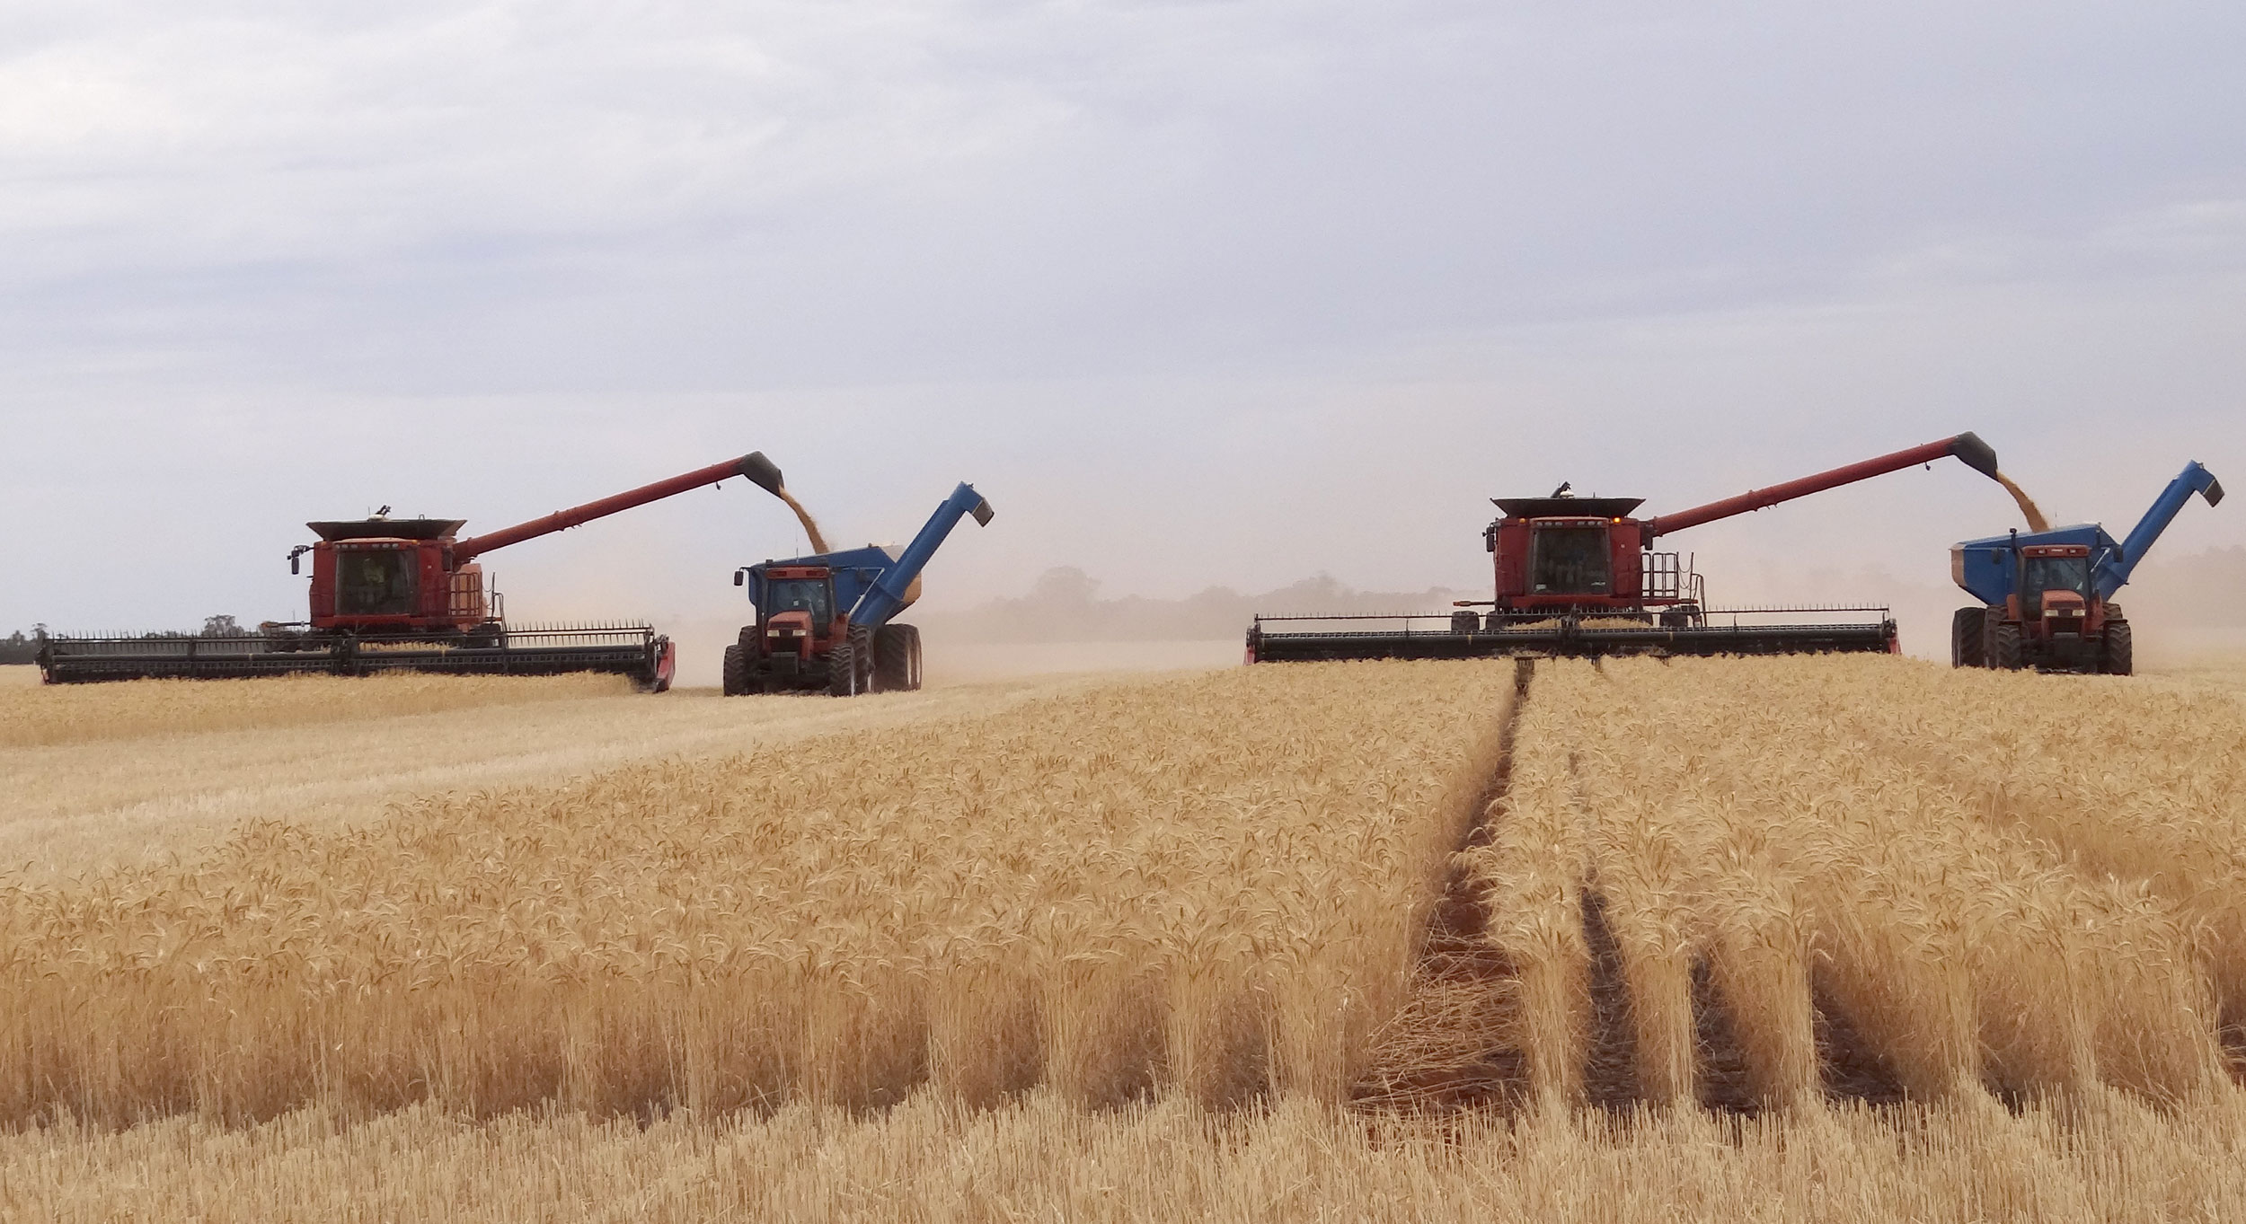
Where does food loss occur?
Harvest – 17%
Handling and storage – 6%
Processing – 9%
Retail – 7%
Consumption stage – 61%
Data from UAO and UMN:
https://www.foodpolicy.umn.edu/policy-summaries-and-analyses/food-loss-and-waste-us-science-behind-supply-chain http://www.fao.org/home/en/

Slide 14
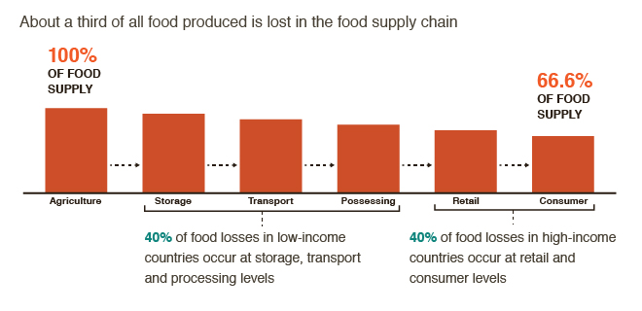
It depends on where you live
Data from CCAFS:
https://ccafs.cgiar.org/bigfacts/#theme=food-emissions&subtheme=supply-chain https://ccafs.cgiar.org/

Slide 15
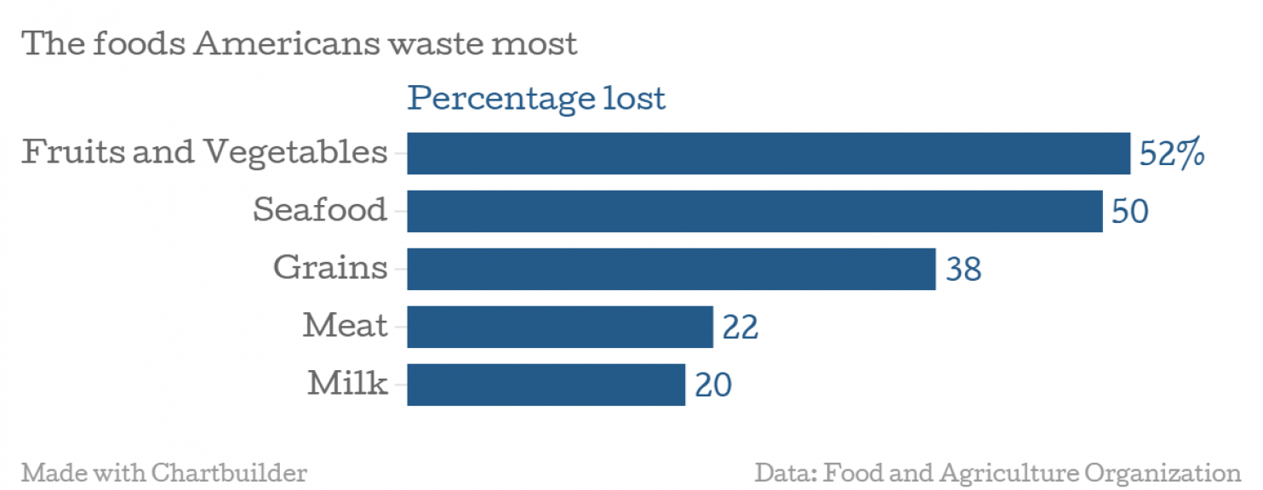
What is being wasted?
From Washington Post:
https://www.washingtonpost.com/news/wonk/wp/2014/09/23/americans-throw-out-more-food-than-plastic-paper-metal-or-glass/?utm_term=.0b5a9264a6404

Slide 16
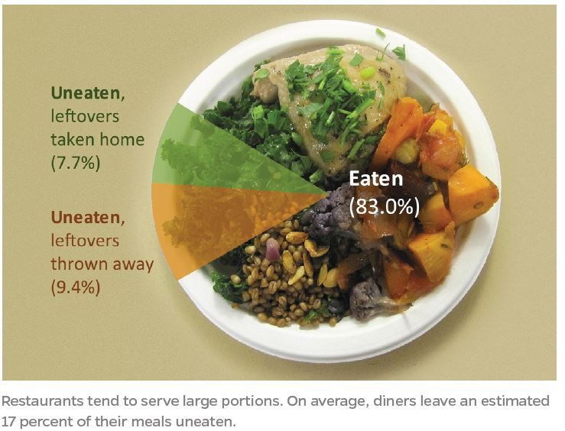
Food waste in restaurants

Slide 17
How much money was lost?
3) Use the formula below to calculate how much money was lost:
$ x 0.4 = $
total amount of money spent amount of money lost

Slide 18
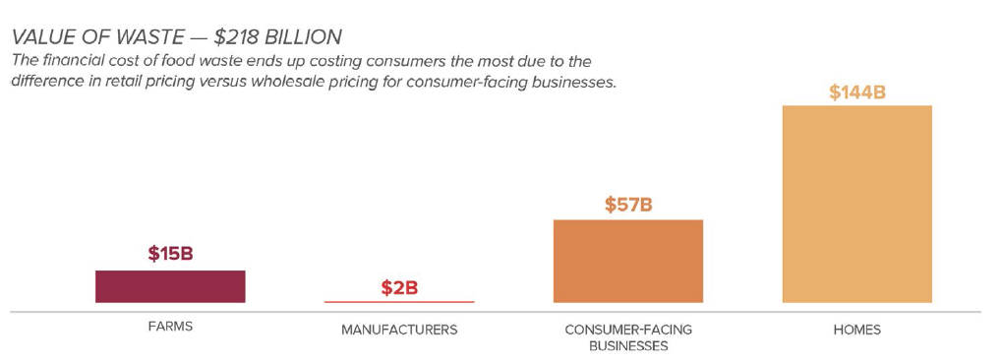
Cost of food waste: residential
Image from ReFed Report

Slide 19
Let’s bring it home
$1,365 to $2,275 annually
Notes:
Pause, doesn’t represent everybody, might not be true for your family today
14.6% food insecure households in Oregon
What is food insecurity?
Since we talk about food security and food insecurity quite a bit here at Food Forward, we thought it would be helpful to define both terms, what they mean, and how we measure them. Here’s our definition: food insecurity refers to a lack of access to enough good, healthy, and culturally appropriate food. There’s a lot going on there, so let’s unpack it a bit.
Enough: this one’s the easiest. Everyone needs to eat, and we all need to eat a certain amount to stay healthy, active, and happy.
Good: this is where things get a bit hairy (or pear-y). Good is a relative word. What’s good food for you might not be good food to your friend, sibling, neighbor, or co-worker. But instead of ignoring the vagueness of this term, we should embrace it! Everybody deserves to eat food that they think is good, right? Nobody should have to eat peas if they hate peas but love carrots (Mom & Dad, are you reading this?).
Healthy: we love healthy food here! Healthy food is nutritious and sustaining. It’s full of vitamins, minerals, fiber, energy, and all the other things that our bodies need to be happy.
Culturally appropriate: like “good”, this term brings us back into the subjective realm. Having access to culturally appropriate food means that people have food that they are familiar and comfortable with. It’s knowing how to shop for it or select it, prepare and cook it, and how to enjoy it! Part of this is availability of familiar foods & varieties, but it also could include things like the language of the label and instructions.
What is food security?
The definition of food security is, as you might imagine, just the opposite! Food security means having reliable access to enough good, healthy, and culturally appropriate food. It means that you or your family aren’t worried about paying for groceries, where your next meal might come from, or cutting back on food in order to pay the bills.
Food security is related to all sorts of other great and wonderful ideals like food justice, food sovereignty, and food equity. While food security is certainly a crucial part of these, concepts such as food justice and food sovereignty tend to have broader social, economic, and cultural implications. So food security is an important part of food justice, but not the whole of it.
https://foodforward.org/2017/10/what-is-food-insecurity/

Slide 20
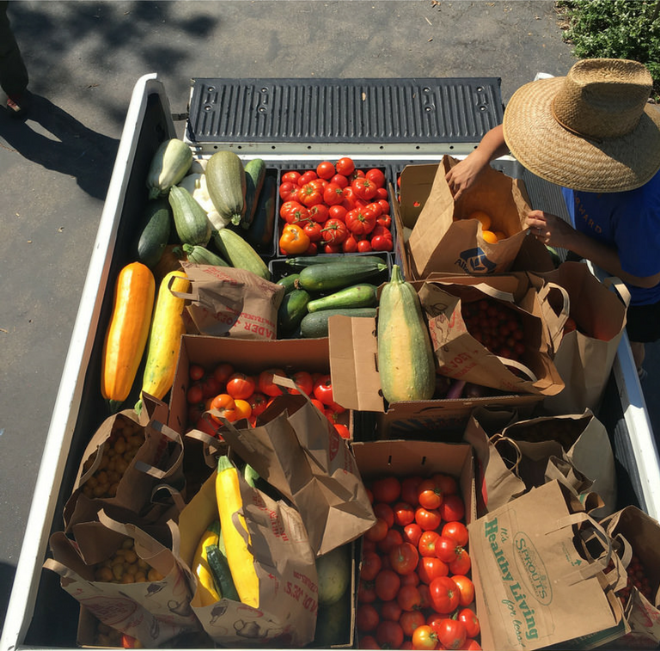
Does everyone have extra?
“Food insecure families look like you and I. There’s not a specific person that a food insecure family looks like. I know that most of the people I functioned around didn’t know that I was food insecure…I wasn’t ‘looking the part’, and
yet I was.”
-Pixie Kastrup
Photo from
https://foodforward.org/2017/10/what-is-food-insecurity/
Notes:
Pause, doesn’t represent everybody, might not be true for your family today
14.6% food insecure households in Oregon
What is food insecurity?
Since we talk about food security and food insecurity quite a bit here at Food Forward, we thought it would be helpful to define both terms, what they mean, and how we measure them. Here’s our definition: food insecurity refers to a lack of access to enough good, healthy, and culturally appropriate food. There’s a lot going on there, so let’s unpack it a bit.
Enough: this one’s the easiest. Everyone needs to eat, and we all need to eat a certain amount to stay healthy, active, and happy.
Good: this is where things get a bit hairy (or pear-y). Good is a relative word. What’s good food for you might not be good food to your friend, sibling, neighbor, or co-worker. But instead of ignoring the vagueness of this term, we should embrace it! Everybody deserves to eat food that they think is good, right? Nobody should have to eat peas if they hate peas but love carrots (Mom & Dad, are you reading this?).
Healthy: we love healthy food here! Healthy food is nutritious and sustaining. It’s full of vitamins, minerals, fiber, energy, and all the other things that our bodies need to be happy.
Culturally appropriate: like “good”, this term brings us back into the subjective realm. Having access to culturally appropriate food means that people have food that they are familiar and comfortable with. It’s knowing how to shop for it or select it, prepare and cook it, and how to enjoy it! Part of this is availability of familiar foods & varieties, but it also could include things like the language of the label and instructions.
What is food security?
The definition of food security is, as you might imagine, just the opposite! Food security means having reliable access to enough good, healthy, and culturally appropriate food. It means that you or your family aren’t worried about paying for groceries, where your next meal might come from, or cutting back on food in order to pay the bills.
Food security is related to all sorts of other great and wonderful ideals like food justice, food sovereignty, and food equity. While food security is certainly a crucial part of these, concepts such as food justice and food sovereignty tend to have broader social, economic, and cultural implications. So food security is an important part of food justice, but not the whole of it.
https://foodforward.org/2017/10/what-is-food-insecurity/

Slide 21
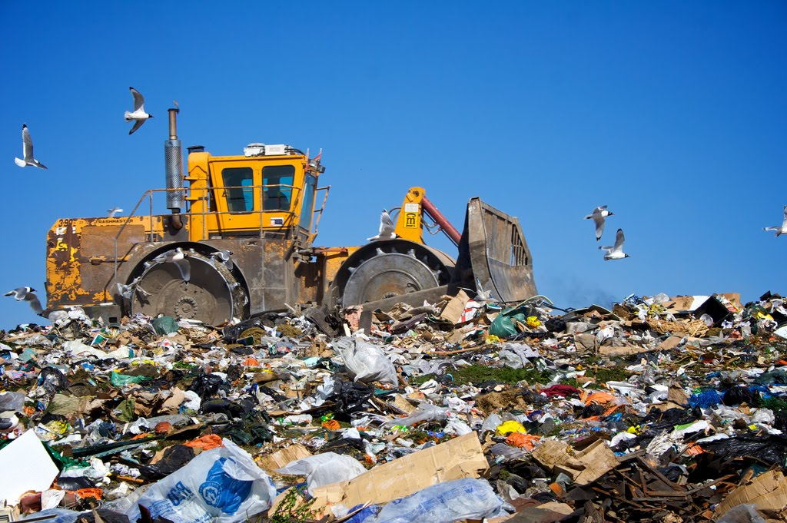
What happens when food waste goes in the trash?
8%

Slide 22
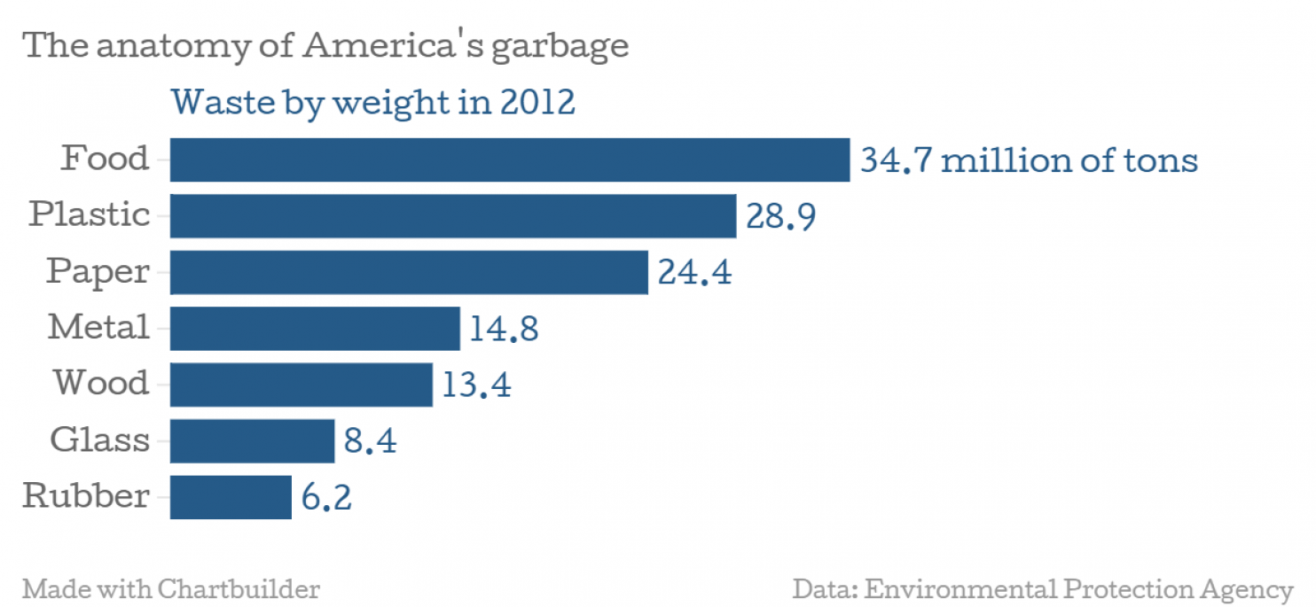
What’s in the garbage?
From Washington Post:
https://www.washingtonpost.com/news/wonk/wp/2014/09/23/americans-throw-out-more-food-than-plastic-paper-metal-or-glass/?utm_term=.0b5a9264a6404

Slide 23
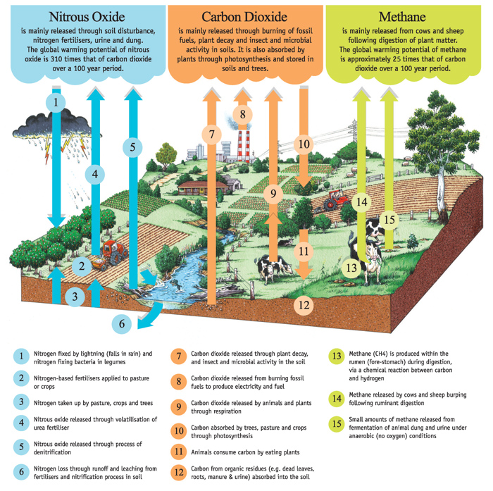
What about climate change?
Agricultural production causes 19-29% of greenhouse gas emissions!
Image from Victoria Agriculture:
www.agriculture.vic.gov.au
Notes:
How many arrows going up?
Agricultural production accounts for
19 - 29%
of global human-caused
greenhouse gas emissions
(Vermeulen et al., 2012).

Slide 24
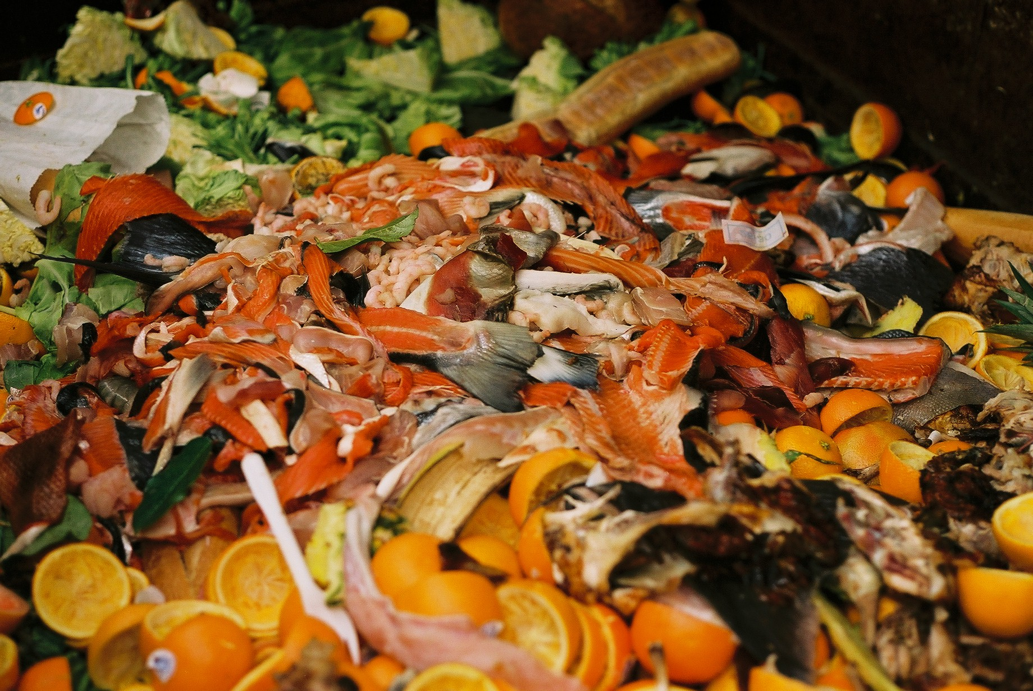
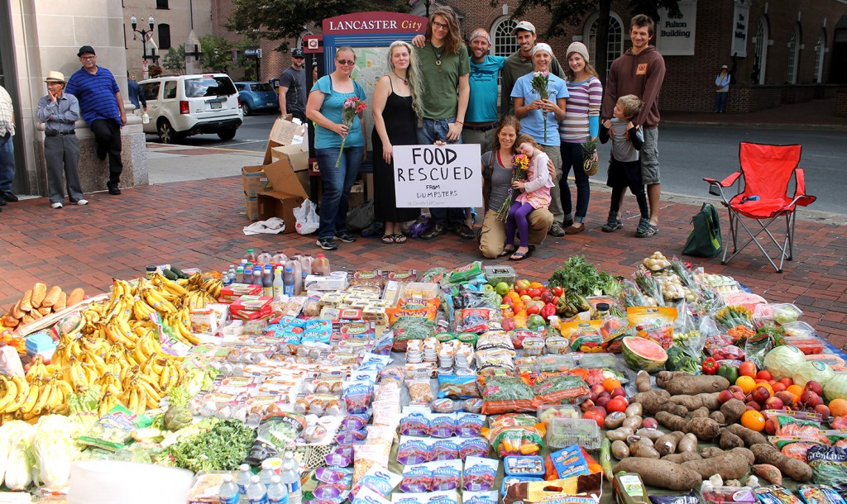
What about climate change?
+8%

Slide 25
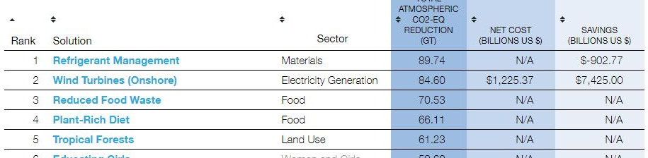
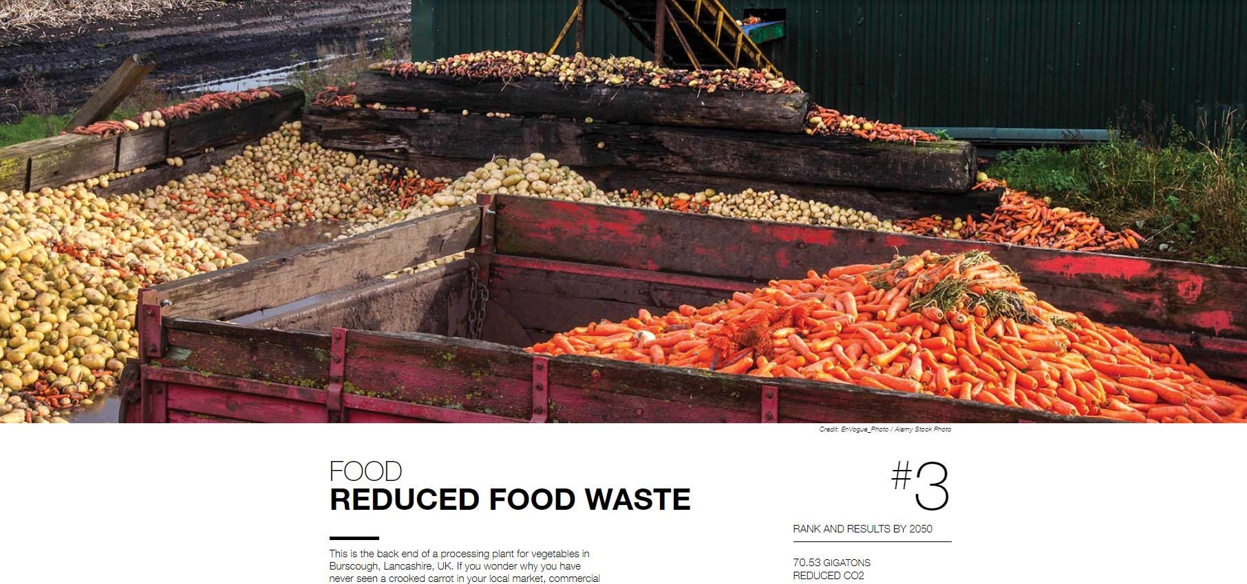
Project Drawdown
From www.drawdown.org

Slide 26
What do you think?
What did you find surprising or interesting about the meal planning activity? What might you do differently if we repeated it?
What can we do to prevent food waste?

Slide 27
How can we prevent food waste?
Photo from Oregon Food Bank
Eat food!
Notes:
For restaurant professionals:
Limited menu choices and flexible portioning
Waste audits
Diners encouraged to take leftovers
Food donations

Slide 28
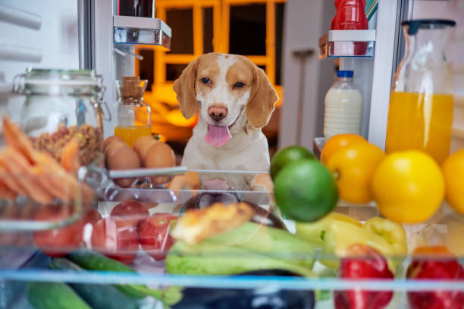
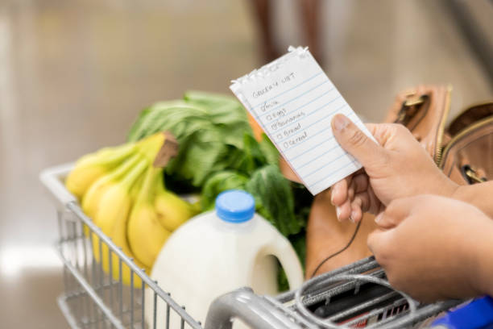
Plan ahead!
Check the shelves before you go
Make a list with meals in mind
…and have a snack first!

Slide 29
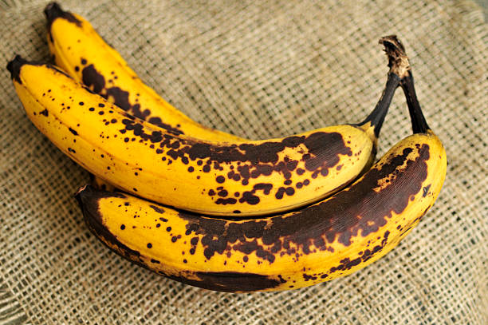
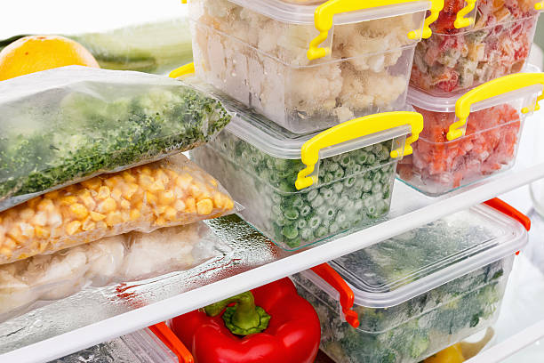
Store it right!
Learn the best places to store different foods
Find new recipes that use leftovers and food scraps
Freeze!
Inspect food before throwing it out

Slide 30
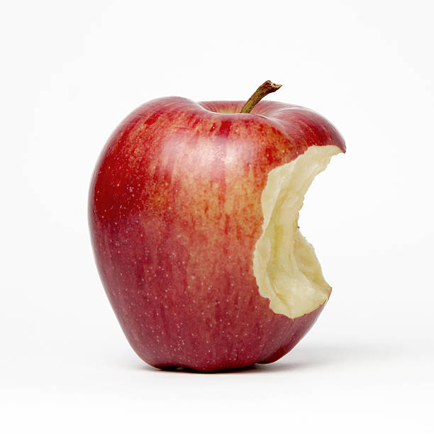
Talk about it!
Share your food preferences with your family
Tell others what you know

Slide 31
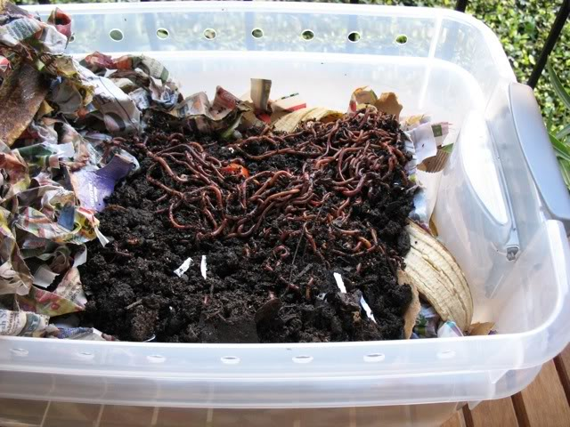
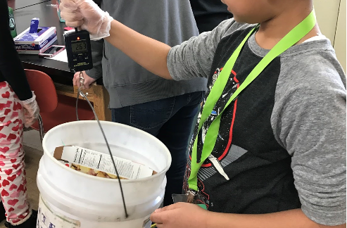
Save your scraps!
Photo from Solana Center:
https://www.solanacenter.org/resources/supplies/mini-worm-bin
Compost at home
Conduct a waste audit

Slide 32
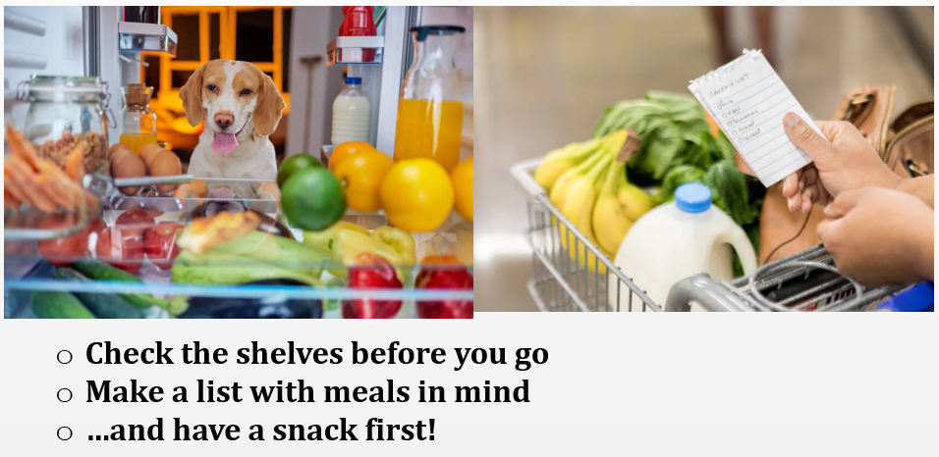
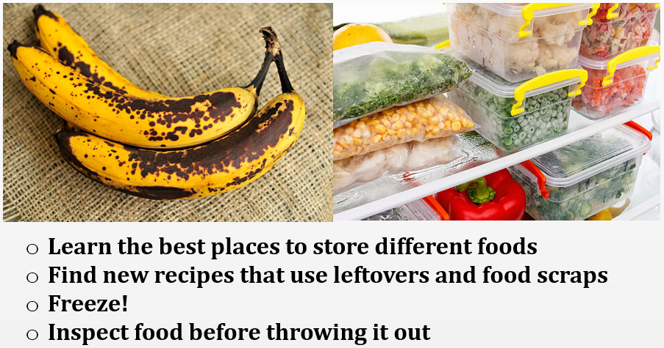
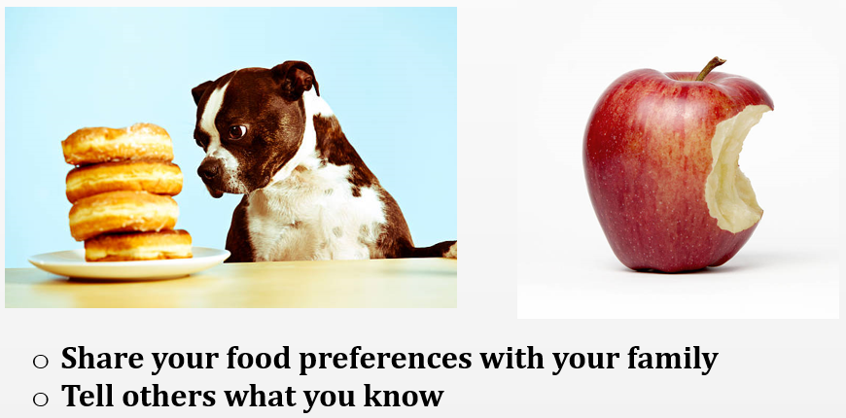
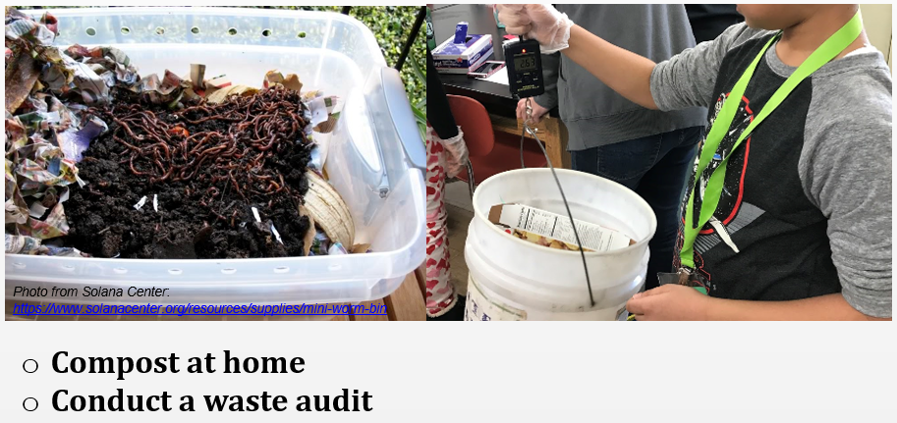
How will you help prevent waste?
Save leftovers – and EAT them!

Slide 33
Food waste hierarchy
High
Low

Slide 34
Food waste hierarchy
First choice
Prevent Waste
Burn for energy
Landfill
Redistribute to people
Anaerobic digestion for energy
Compost
Feed animals
Last choice
Litter and marine debris

Slide 35
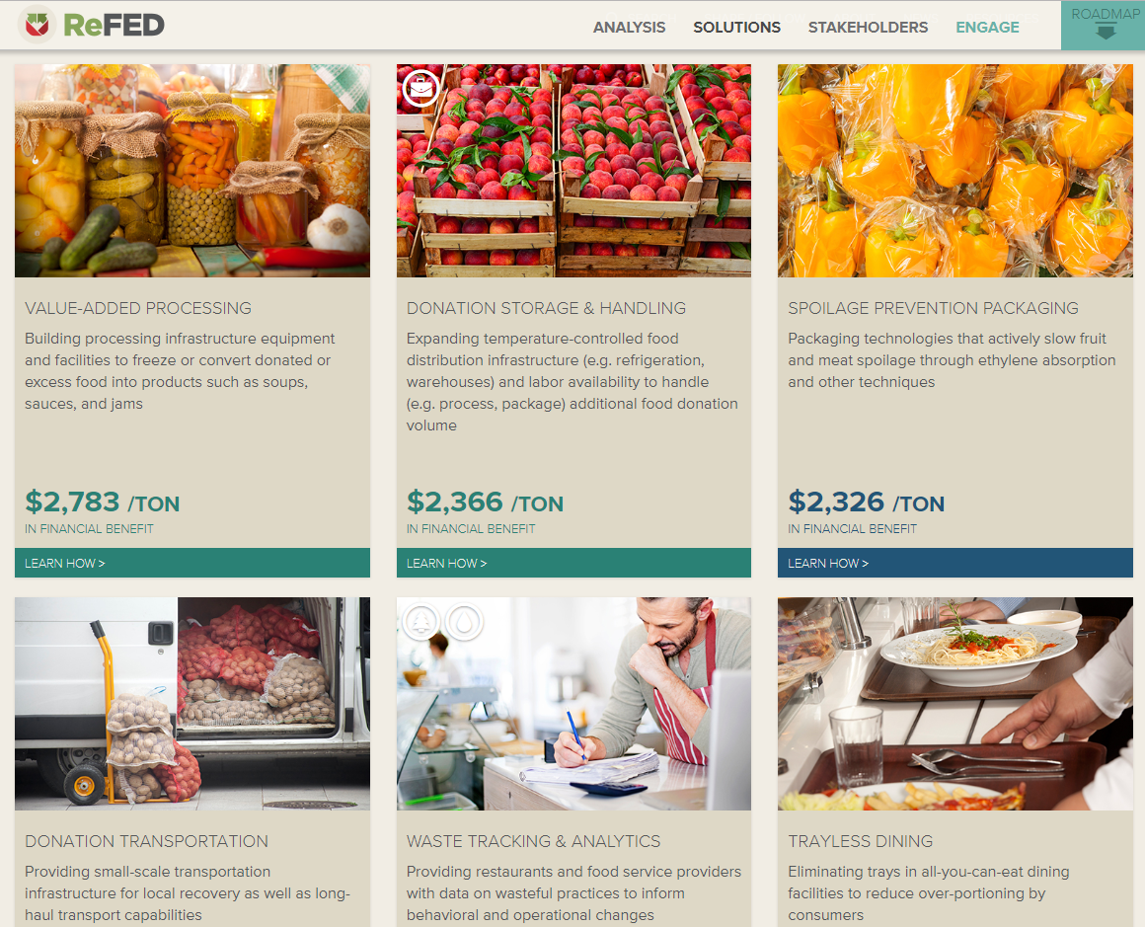
Beyond home

Slide 36
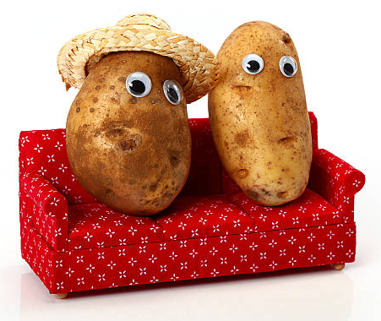
Resources
Eat Smart, Waste Less challenge
www.eatsmartwasteless.com
Save The Food resources
www.savethefood.com
Further With Food resources
www.furtherwithfood.com
City of Beaverton tips and resources
https://www.beavertonoregon.gov/1559/More-Resources

Slide 37
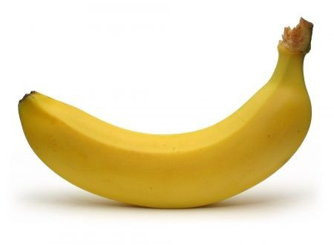
Banana supply chain

Slide 38
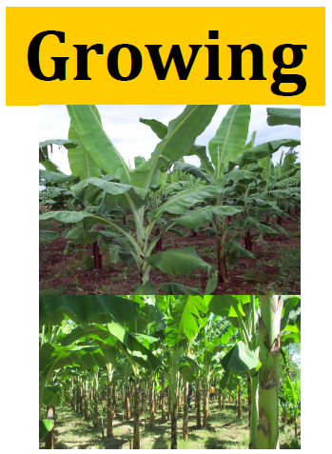
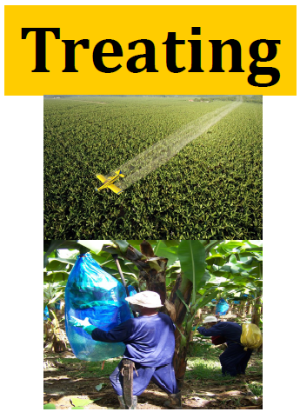
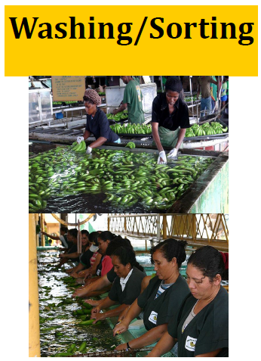
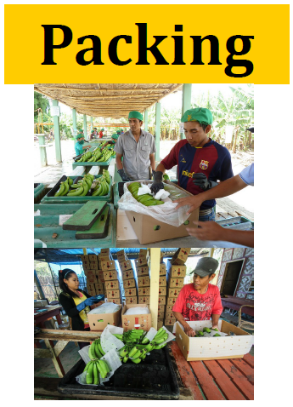
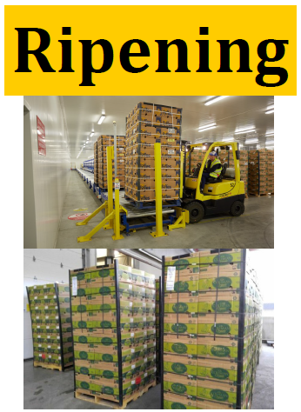
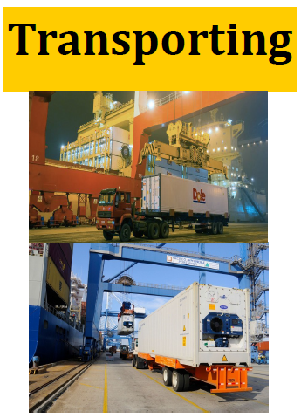
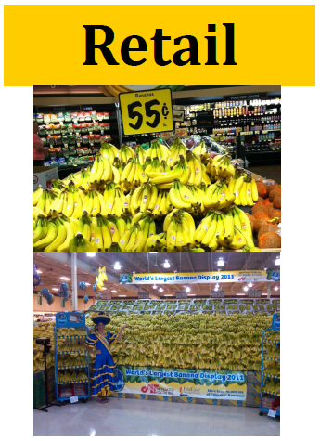
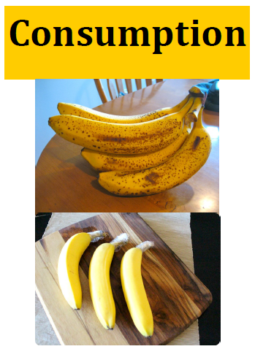
Banana supply chain

